Slide 1
BUFFER CACHE

Slide 2
Kernel Architecture (UNIX)
User program
Library
User level
system call interface
kernel level
File Subsystem
Inter process
communication
Buffer Cache
Process Control
Subsystem
Scheduler
Memory Management
character block
Device driver
Hardware control
kernel level
hardware
Hardware level

Slide 3
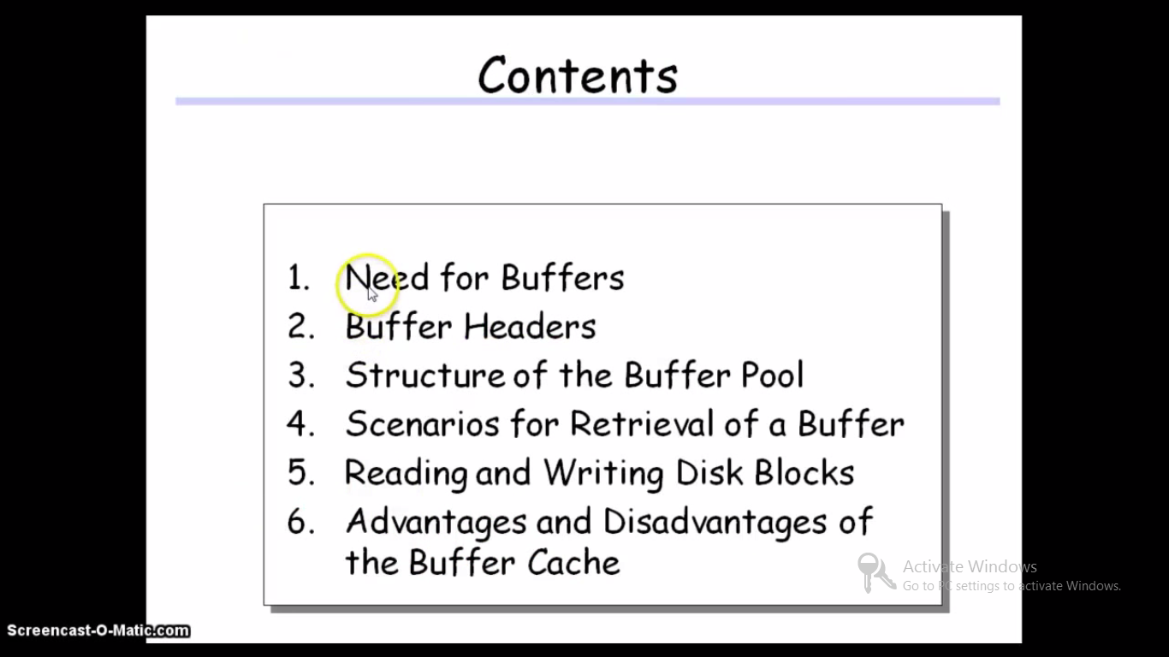

Slide 4
Buffer Cache
The kernel could read and write directly to and from the disk for all the file system accesses but system response time and throughput would be poor because of the slow disk transfer rate.
The kernel therefore attempts to minimize the frequency of disk access by keeping a pool of internal data buffers, called the buffer cache.

Slide 5
Need for Buffer Cache
Reading information from the disk
Very slow
Reading same part of the disk several times within short periods
Reduces response time and throughput of the system
Solution - Buffer Cache
Reading the information from disk - once
Keeping it in part of main memory - for subsequent access
Speeds up all except the first read
Part of main memory used for this purpose - Buffer Cache

Slide 6
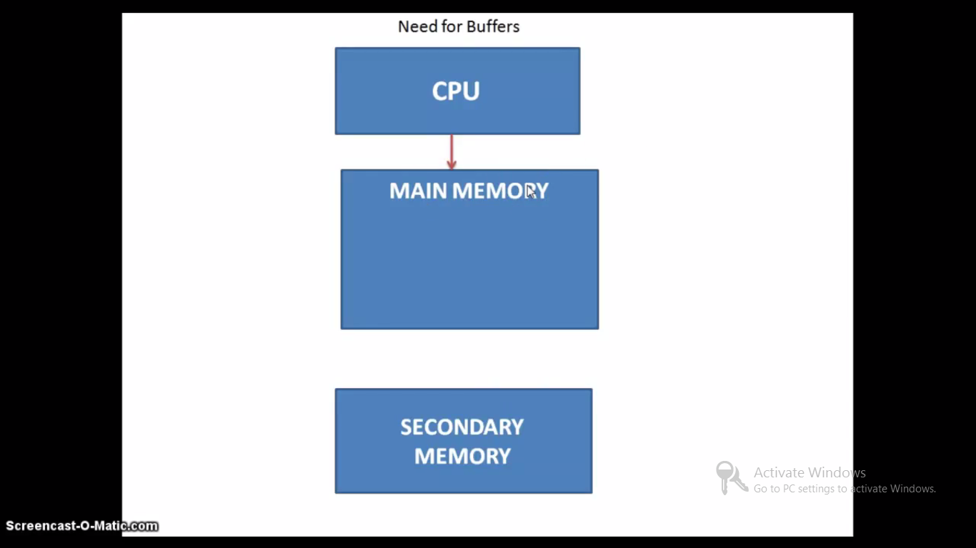

Slide 7
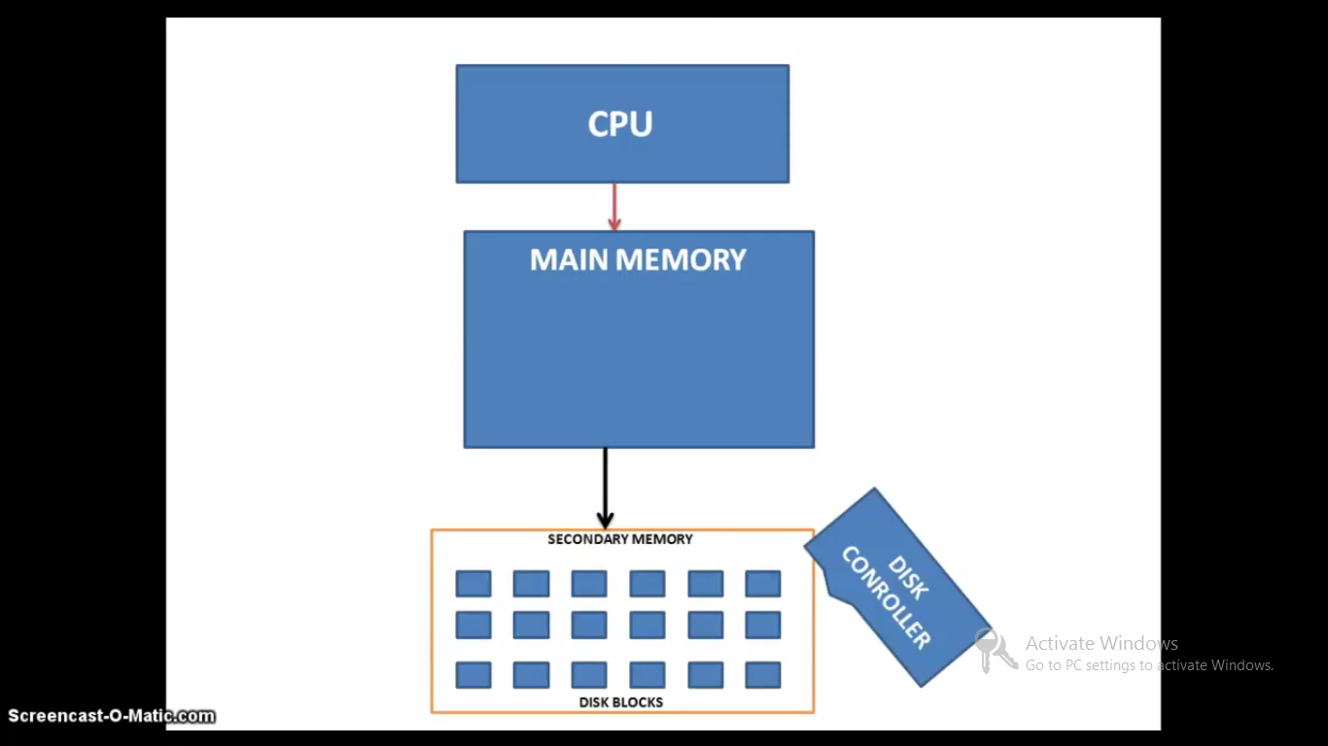

Slide 8
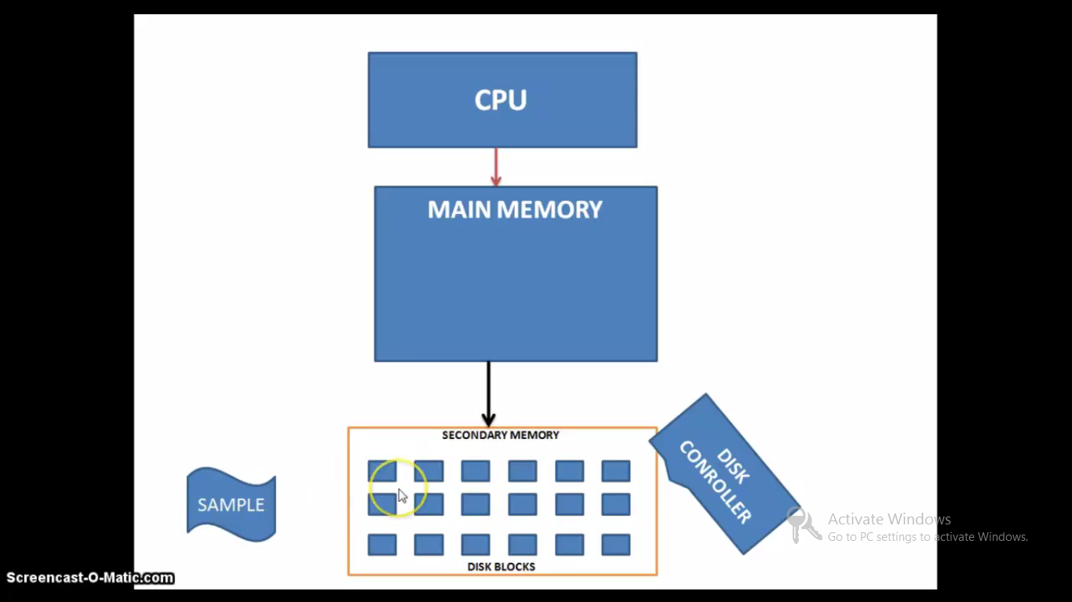

Slide 9
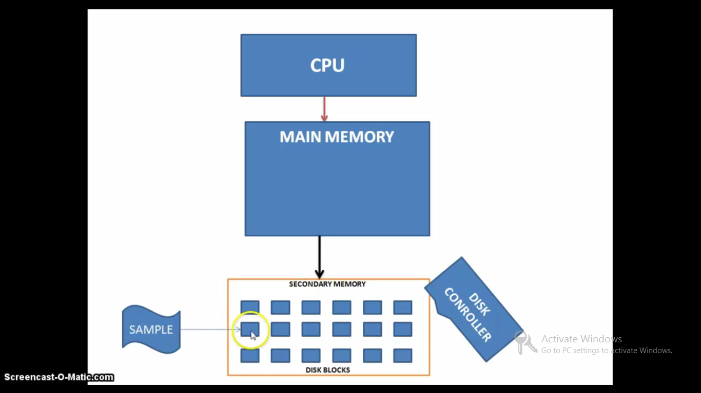

Slide 10
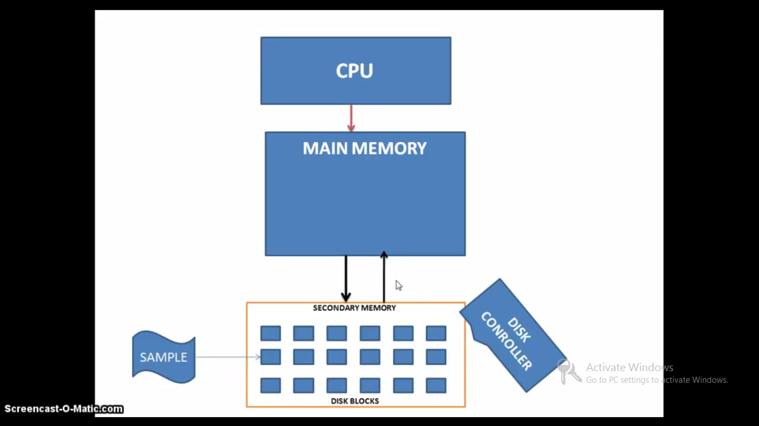

Slide 11
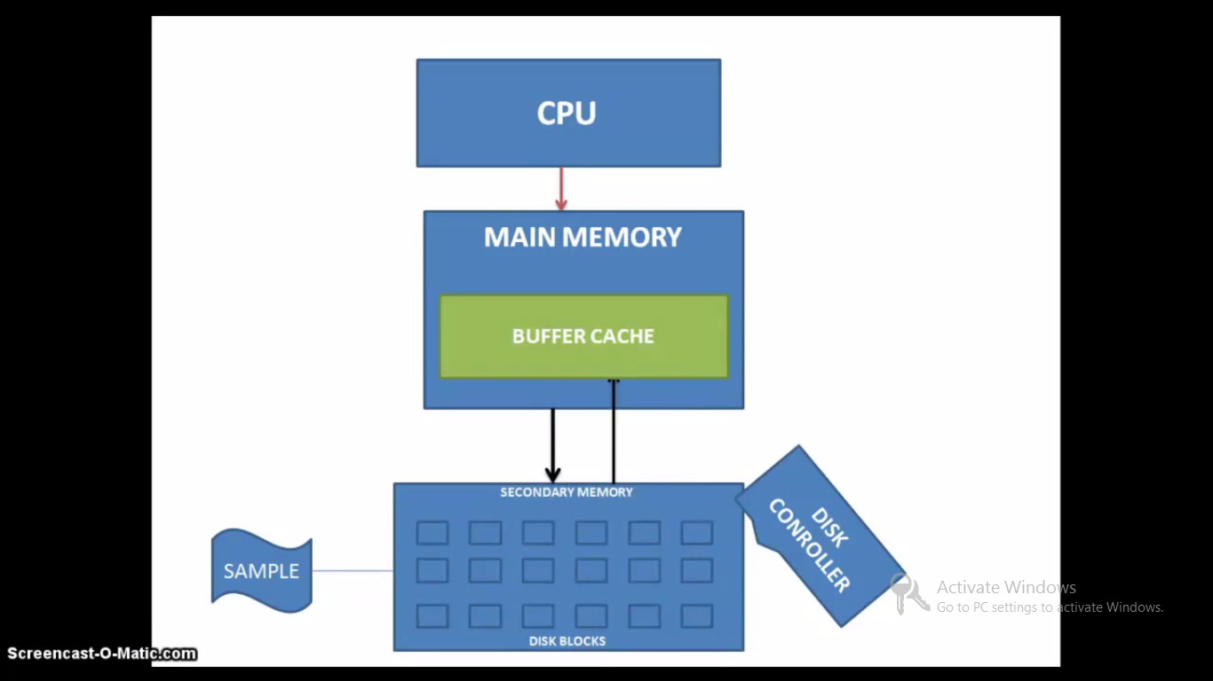

Slide 12
Buffer Headers
During system initialization, the kernel allocates space for a number of buffers, configurable according to memory size and system performance constraints.
A buffer consists of two parts:
A memory array that contains data from the disk.
A buffer header that identifies the buffer.

Slide 13
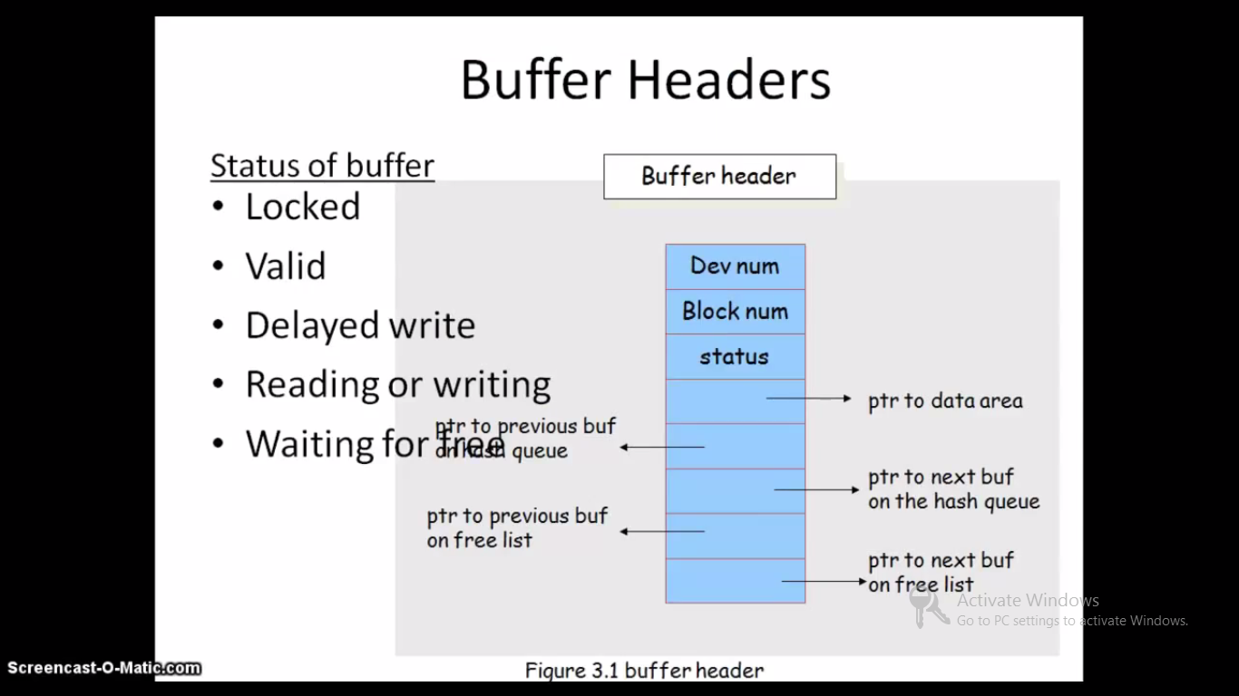

Slide 14
Buffer Headers
device num
logical file system number
block num
block number of the data on disk
status
The buffer is currently locked.
The buffer contains valid data.
delayed-write
The kernel is currently reading or writing the contents of the disk.
A process is currently waiting for the buffer to become free.
kernel identifies the buffer content by examining device num and block num.

Slide 15
Buffer Headers
struct buffer_head{
/*First cache line: */
struct buffer_head *b_next; /*Hash queue list*/
unsigned long b_blocknr; /*block number*/
unsigned long b_size; /*block size*/
kdev_t b_dev; /*device(B_FREE = free)*/
kdev_t b_rdev; /*Read device*/
unsigned long b_rsector; /*Real Buffer location on disk*/
struct buffer_head *b_this_page; /*circular list of buffers in one page*/
unsigned long b_state; /*buffer state bitmap(see above)*/
struct buffer_head *b_next_free;
unsigned int b_count; /*users using this block*/
char *b_data; /*pointer to data block(1024 bytes)*/
unsigned int b_list; /*List that this buffer appears*/
unsigned long b_flushtime; /*Time when this(dirty) buffer should be written*/
struct wait_queue *b_wait;
struct buffer_head **b_pprev; /*doubly linked list of hash-queue*/
struct buffer_head *b_prev_free; /* double linked list of buffers*/
struct buffer_head *b_reqnext; /*request queue*/
/*I/O completion*/
void (*b_end_io)(struct buffer_head *bh, int uptodate);
void *b_dev_id;
};

Slide 16
Buffer Headers
/* buffer head state bits*/
#define BH_Uptodate 0 /*1 if the buffer contains
valid data*/
#define BH_Dirty 1 /*1 if the buffer is dirty*/
#define BH_Lock 2 /*1 if the buffer is locked*/
#define BH_Req 3 /*0 if the buffer has been
invalidated*/
#define BH_Protected 6 /*1 if the buffer is
protected*/

Slide 17
Buffer Headers
The data in a buffer corresponds to the data in a logical disk block on a file system.
The kernel identifies the buffer contents by examining identifier fields in the buffer header.

Slide 18
Buffer Headers
The buffer is the in-memory copy of the disk block;
The contents of the disk block map into the buffer, but the mapping is temporary until the kernel decides to map another disk block into the buffer. A disk block can never map into more than one buffer at a time.
If two buffers were to contain the data for one disk block, the kernel would not know which buffer contained the current data and could write incorrect data back

Slide 19
Buffer Headers
The buffer headers contains a device number field and a block number field that specifies the file system and block number of the data on disk and uniquely identify the buffer.

Slide 20
Buffer Headers
The device number is the logical file system number, not a physical device (disk) unit number.
The buffer header also contains a pointer to a data array for the buffer, whose size must be at least as big as the size of a disk block.
The buffer header contains a status field that summarizes the current status of the buffer.

Slide 21
Buffer Headers
The status of a buffer is a combination of following conditions:
The buffer is currently locked. (lock, busy or free, unlock).
If the buffer contains valid data then
The kernel must write the buffer contents to disk before reassigning the buffer; if the buffer is marked as delayed write.

Slide 22
Buffer Headers
If the kernel is currently reading or writing the contents of the buffer to disk
A process is currently waiting for the buffer to become free
The buffer header also contains two sets of pointers; used by the buffer allocation algorithms to maintain the overall structure of the buffer pool.

Slide 23
Structure of the buffer pool – Free list
The kernel maintains a free list of buffers that preserves the least recently used order.
The free list is a doubly linked circular list of buffers with a dummy buffer header that marks its beginning and end.
Every buffer is put on the free list when the system is booted.

Slide 24
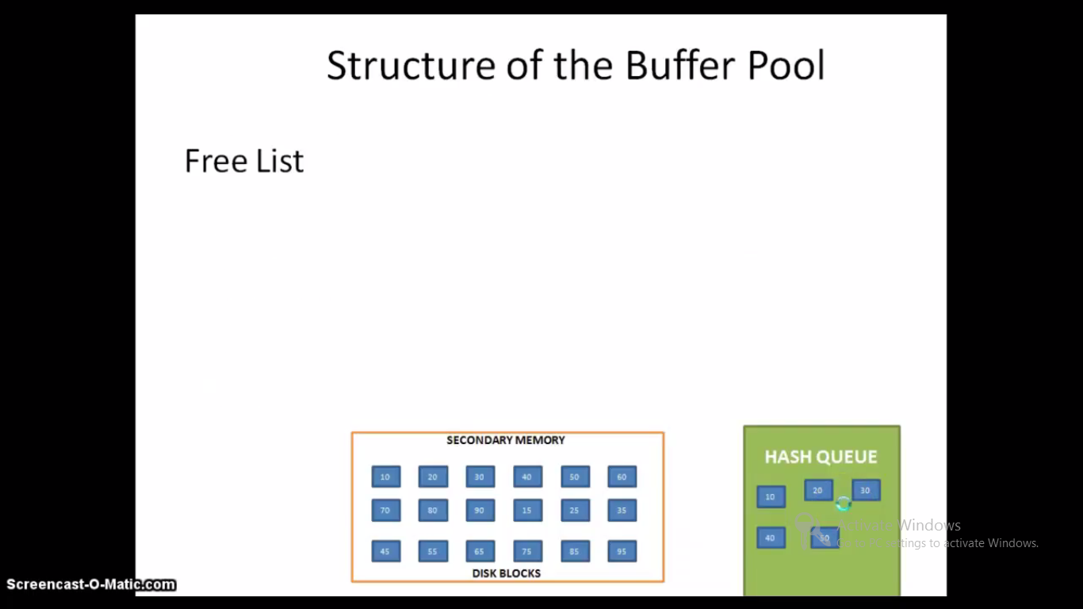

Slide 25
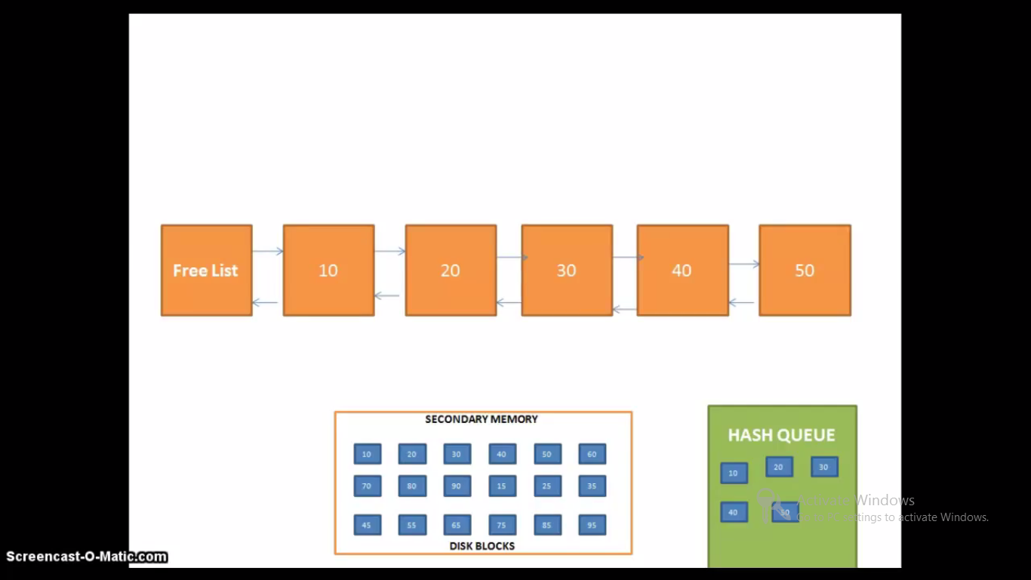
Process p1 requests for file in block number 30

Slide 26
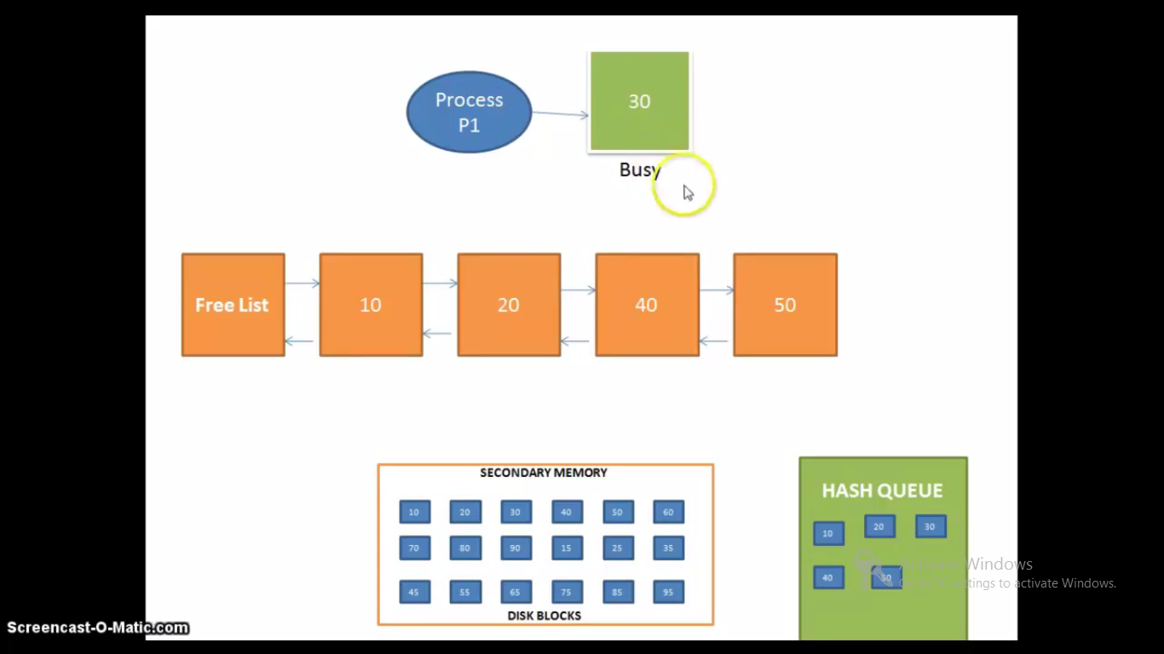

Slide 27
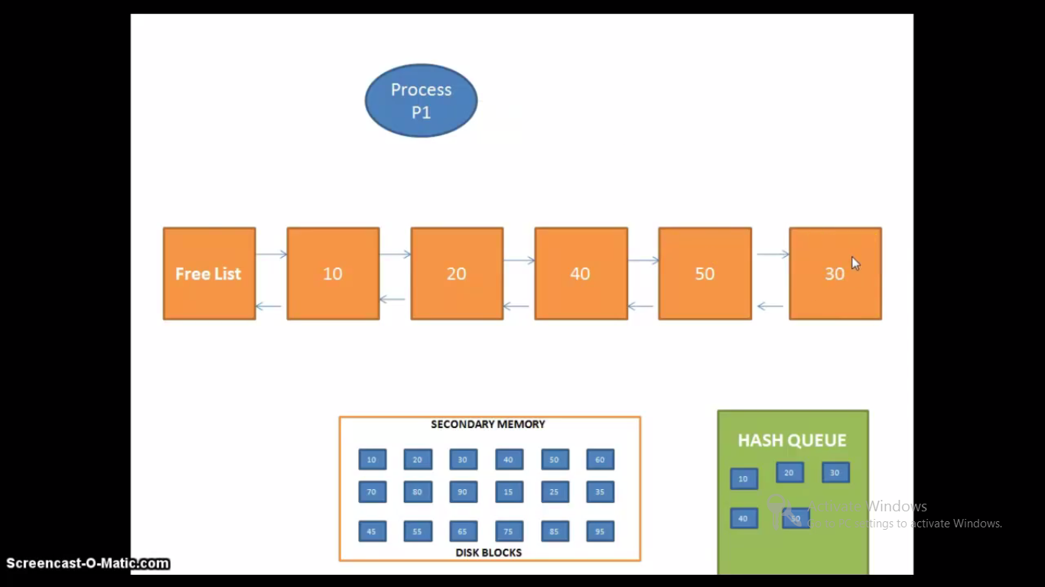
Process p1 requests for a file in block number 25

Slide 28
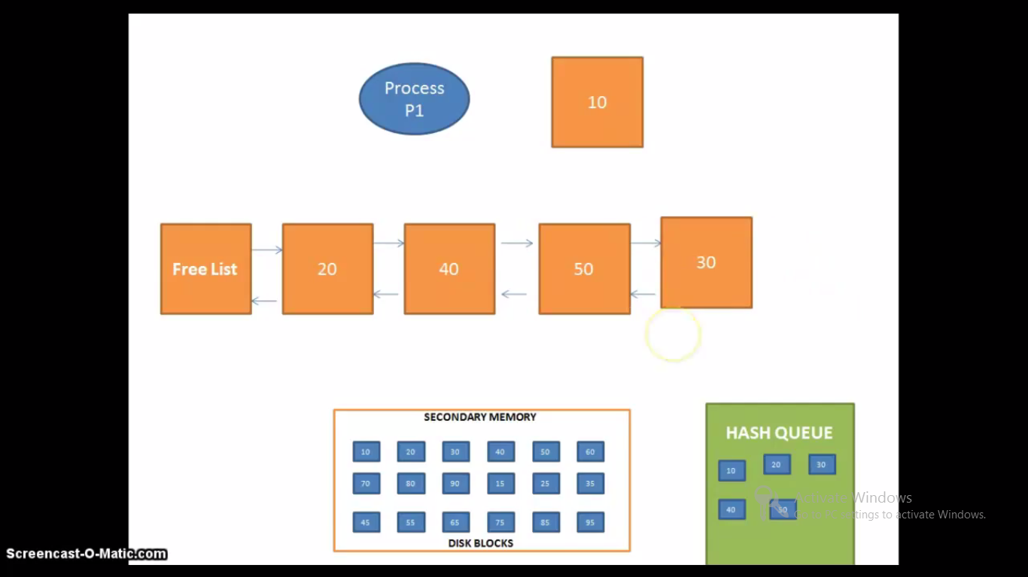

Slide 29
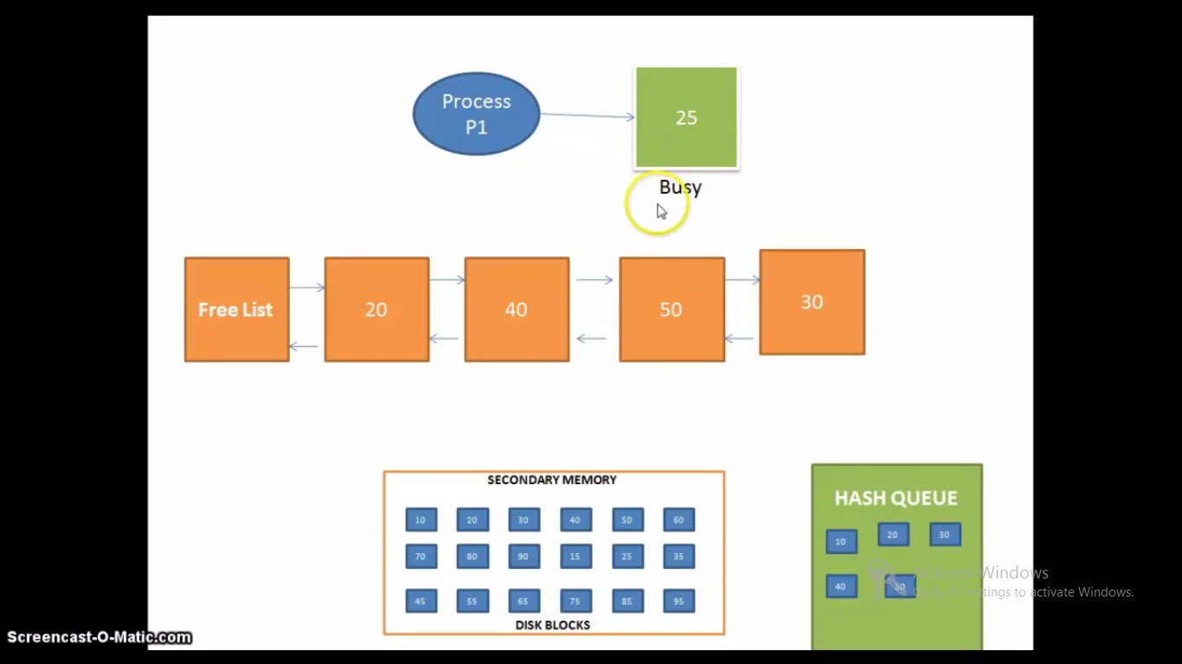

Slide 30
Structure of the buffer pool
The kernel takes a buffer from the head of the free list (case 1) when it wants any free buffer,
But it can take a buffer from the middle of the free list (case 2), if it identifies a particular block in the buffer pool.
In both cases, it removes the buffer from the free list.

Slide 31
Structure of the buffer pool
After the buffer becomes idle, when the kernel returns a buffer to the buffer pool, it usually attaches the buffer
to the tail of the free list,
occasionally to the head of the free list (for error cases),
but never to the middle.
As the kernel removes buffers from the free list, a buffer with valid data moves closer and closer to head of the free list

Slide 32
Structure of the buffer pool – Hash Queue
Rather than search the entire buffer pool, kernel organizes the buffers into separate queues, hashed as a function of the device and block number.
The kernel links the buffer on a hash queue into a circular, doubly linked list similar to structure of the free list.

Slide 33
Structure of the buffer pool– Hash Queue
The number of buffers on a hash queue varies during the lifetime of the system.
The kernel must use a hashing function that distributes the buffers uniformly across the set of hash queue.
Hash function must be simple so that performance does not suffer.
System administrators configure the number of hash queues when generating the operating system.

Slide 34
Structures of the buffer pool– Hash Queue
The below figure shows buffers on their hash queues.
The headers of the hash queues are on the left side of the figure and the squares on each row are buffers on a hash queue
Hash queue headers
28
4
64
blkno0 mod 4
blkno1 mod 4
17
5
97
blkno2 mod 4
98
50
10
blkno3 mod 4
3
35
99
Buffers on the Hash Queues

Slide 35
Structure of the buffer pool
Thus, squares marked 28, 4, 64 represent buffers on the hash queue for blk no 0 mod 4.
Dotted lines between the buffers represent the forward and backward pointers for the hash queue.

Slide 36
Structure of the buffer pool– Hash Queue
The fig., identifies blocks only by their blk no., and it uses a hash function dependent only on a blk no., however, implementation use the device no., too.
Each buffer always exists on a hash queue, but there is no significance to its position on the queue.

Slide 37
Structure of the buffer pool
No two buffers may simultaneously contain the contents of the same disk block; therefore, every disk block in the buffer pool exists on one and only one hash queue and only once on that queue.
However, a buffer may be on the free list as well if its status is free.
Because a buffer may be simultaneously on a hash queue and on the free list;

Slide 38
Structure of the buffer pool
The kernel has two ways to find it;
It searches the hash queue if it is looking for a particular buffer, and
It removes a buffer from the free list if it is looking for any free buffer.
A buffer is always on a hash queue, but it may or may not be on the free list.

Slide 39
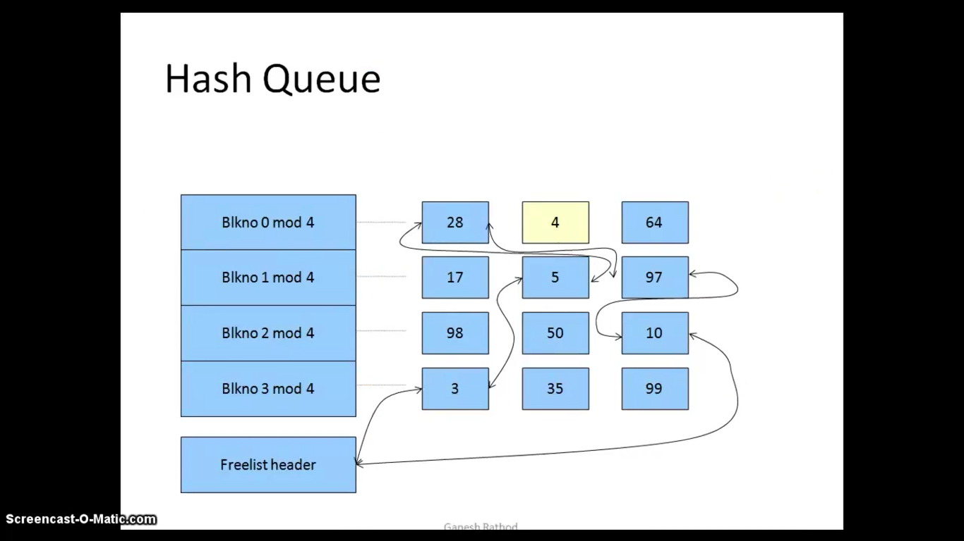

Slide 40
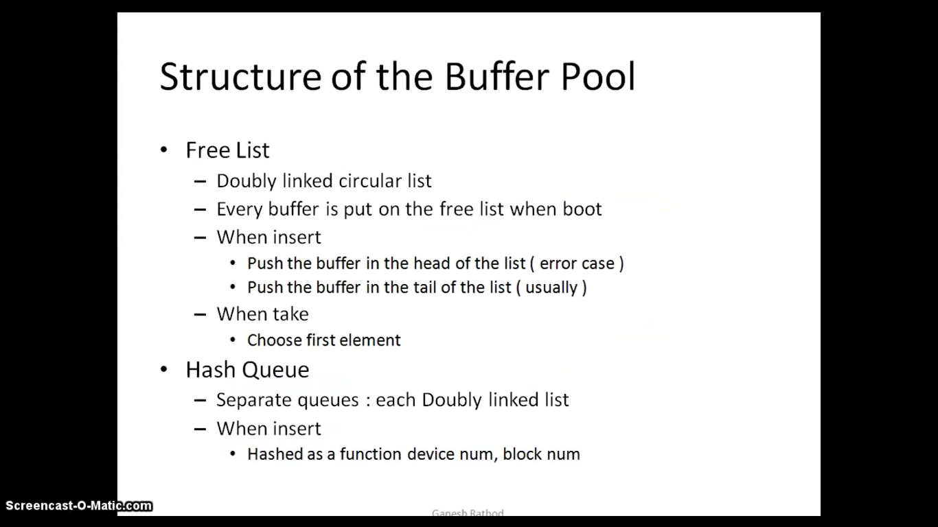

Slide 41
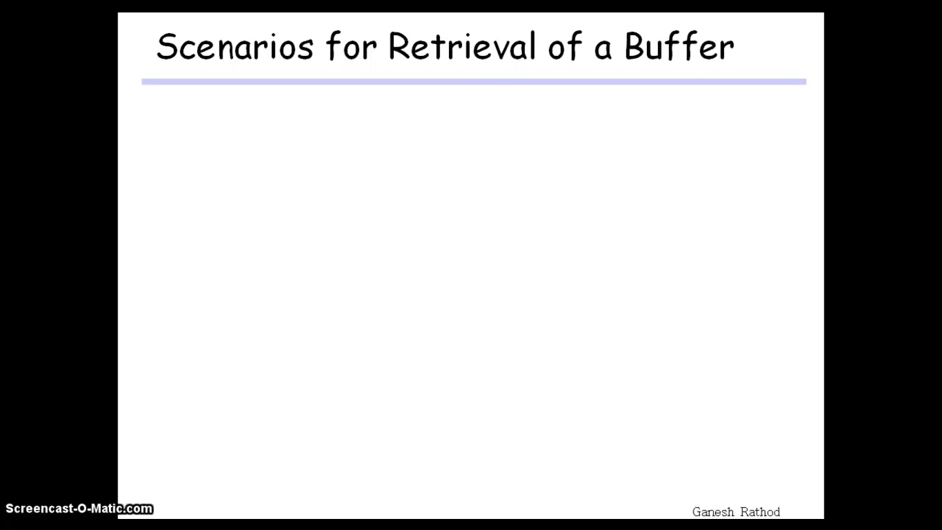

Slide 42
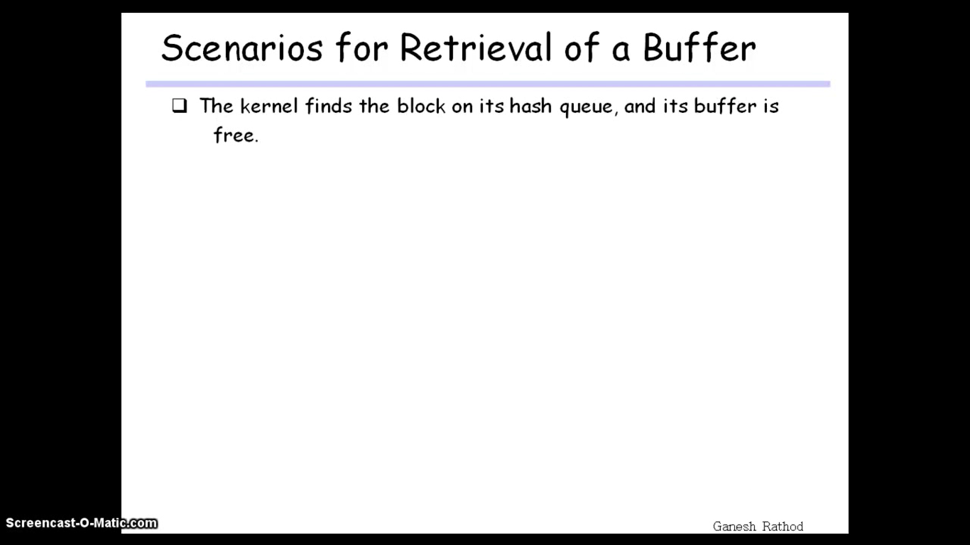

Slide 43
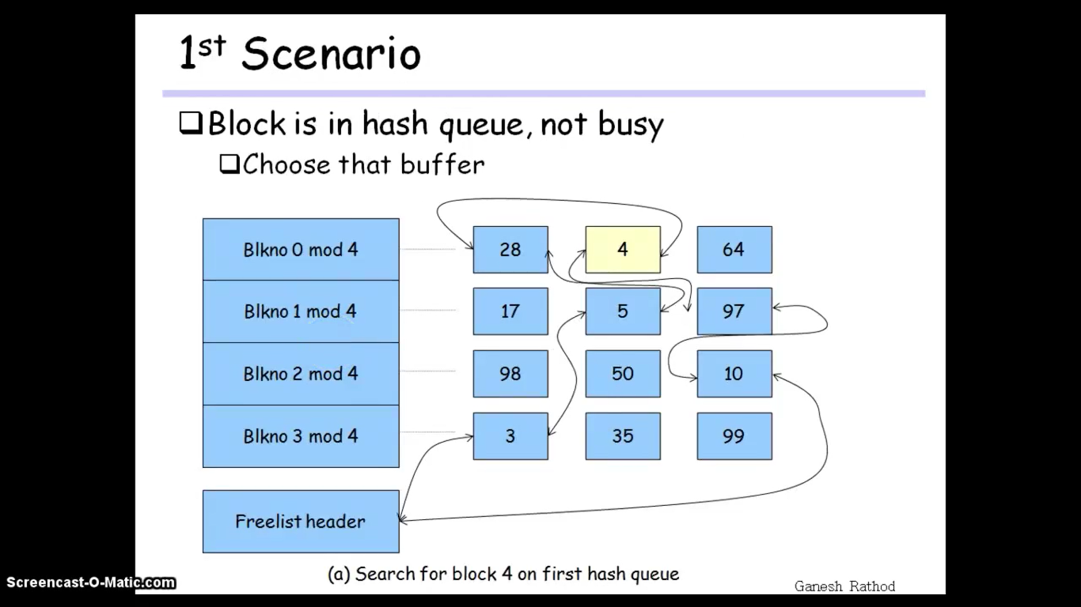

Slide 44
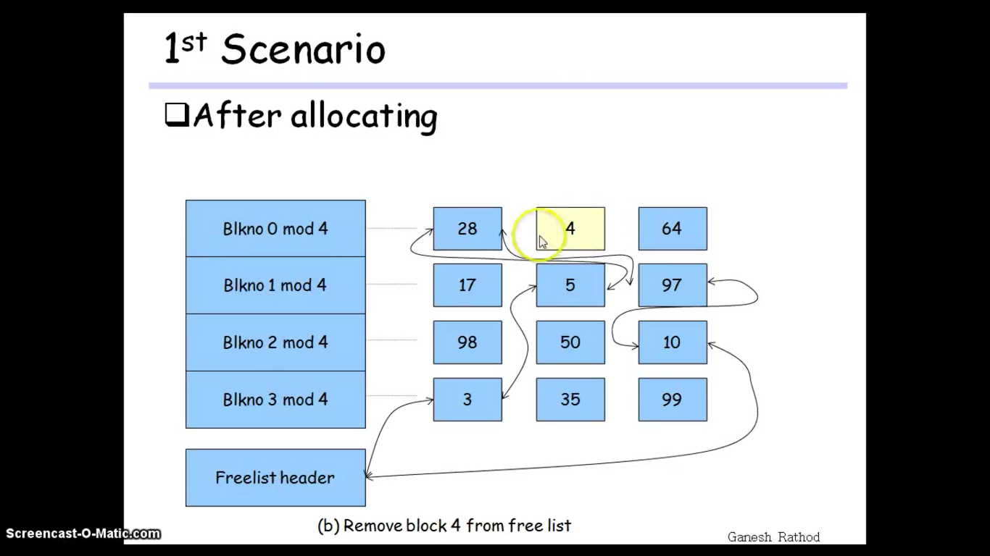

Slide 45
Scenario 1
The kernel removes the buffer(4) from the free list, leaves the buffer marked busy; no other process can access it and change its contents while it is busy, thus preserving the integrity of the data in the buffer.
When the kernel finishes using the buffer, it releases the buffer.
It wakes up processes that had fallen asleep because the buffer was busy and processes that had fallen asleep because no buffers remained on the free list.
The kernel places the buffer at the end of the free list, unless an I/O error occurred or unless it specifically marked the buffer "old," as will be seen later.
Else it places the buffer at the beginning of the free list. The buffer is now free for another process to claim it.
The kernel raises the processor execution level to prevent disk interrupts while manipulating the free list, thereby preventing corruption of the buffer pointers

Slide 46
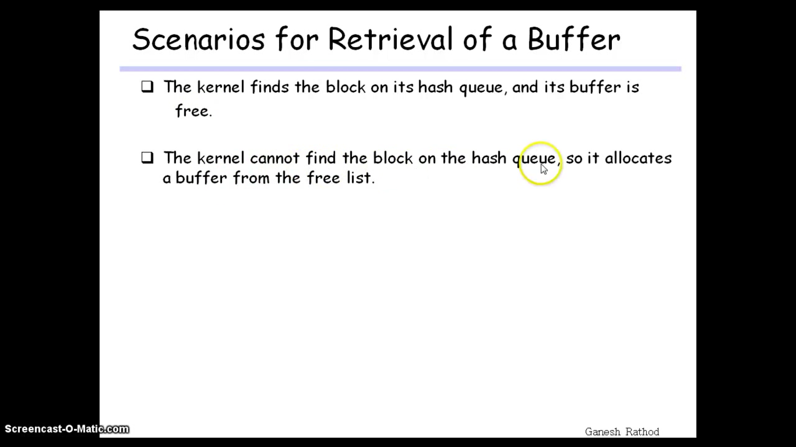

Slide 47
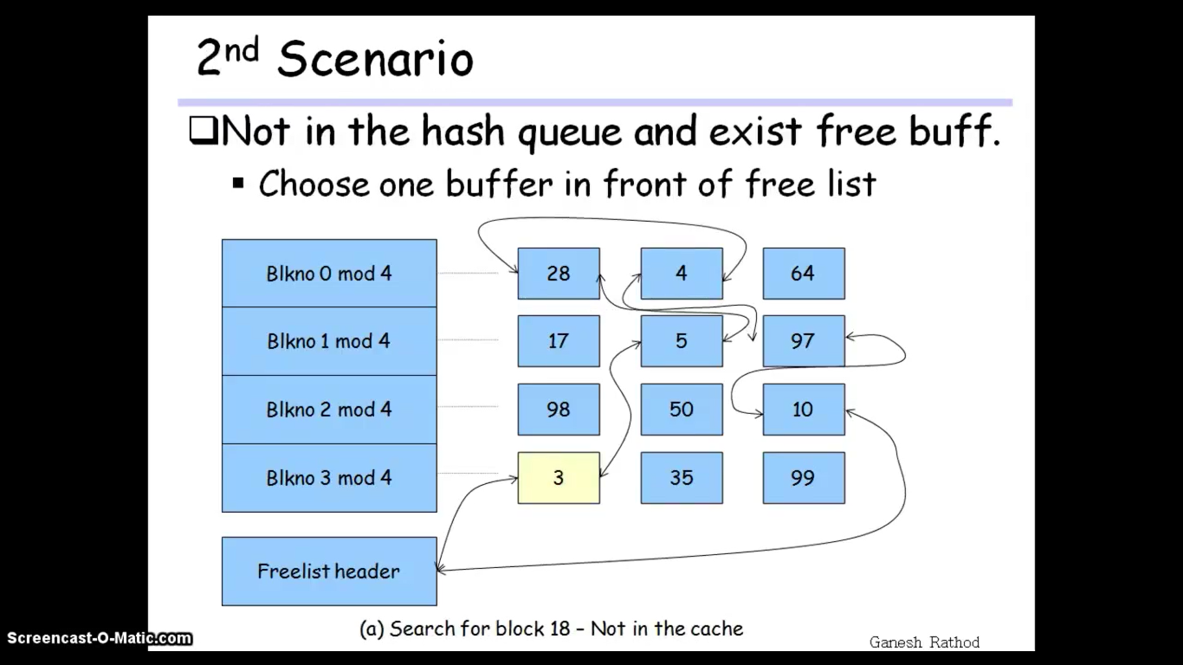

Slide 48
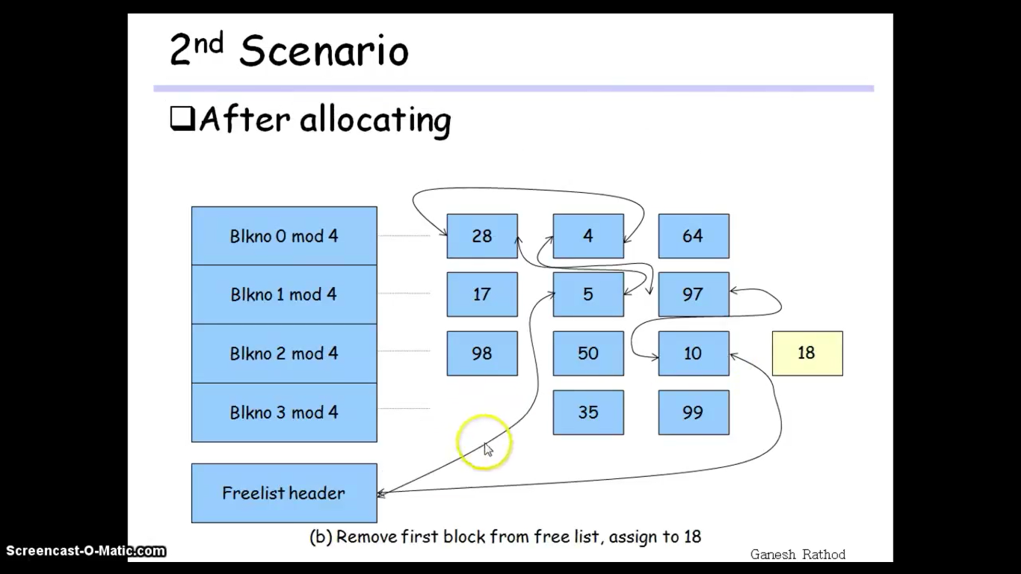

Slide 49
Scenario 2
When kernel could not find the requested buffer, The kernel removes the first buffer from the free list instead; that buffer had been allocated to another disk block and is also on a hash queue.
The kernel marks the buffer busy, removes it from the hash queue where it currently resides, reassigns the buffer header's device and block number to that of the disk block for which the process is searching, and places the buffer on the correct hash queue.
Another process searching for the old disk block (3), will not find it in the pool and will have to allocate a new buffer for it from the free list.
When the kernel finishes with the buffer, it releases it.

Slide 50
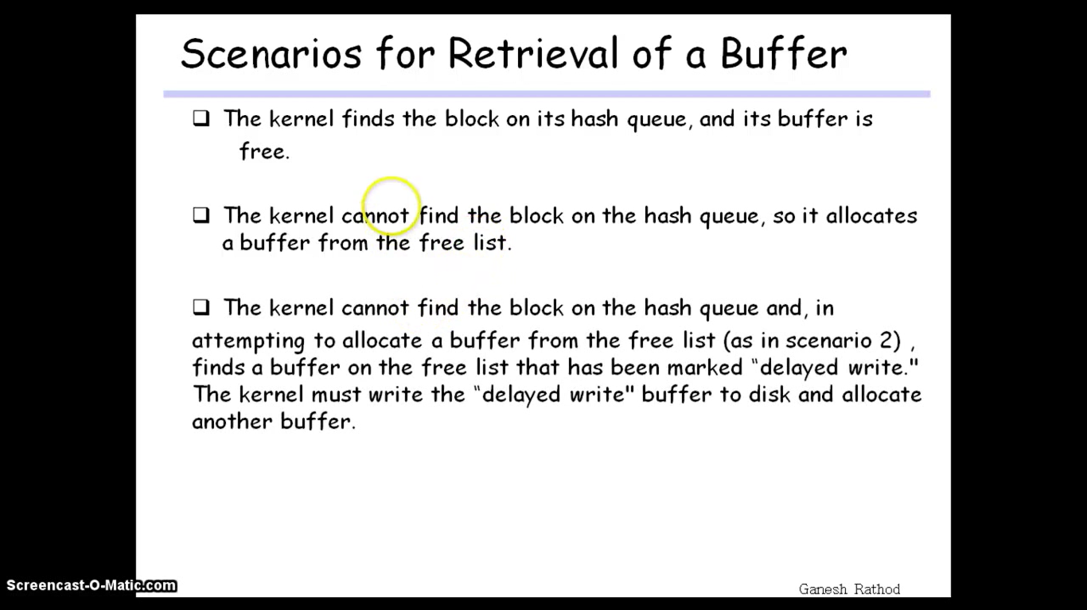

Slide 51
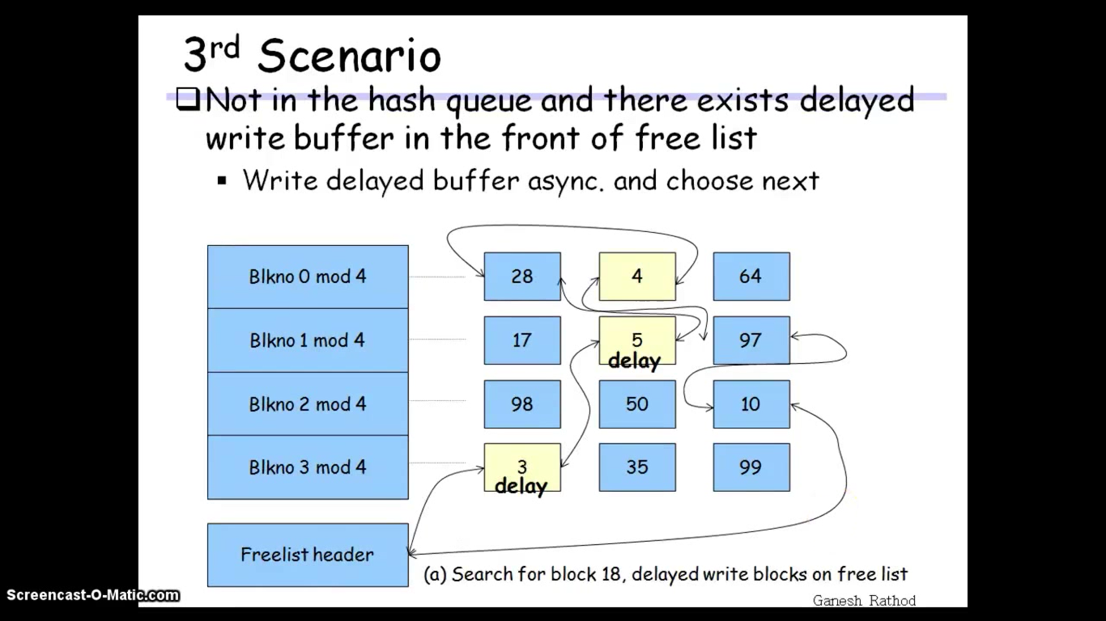

Slide 52
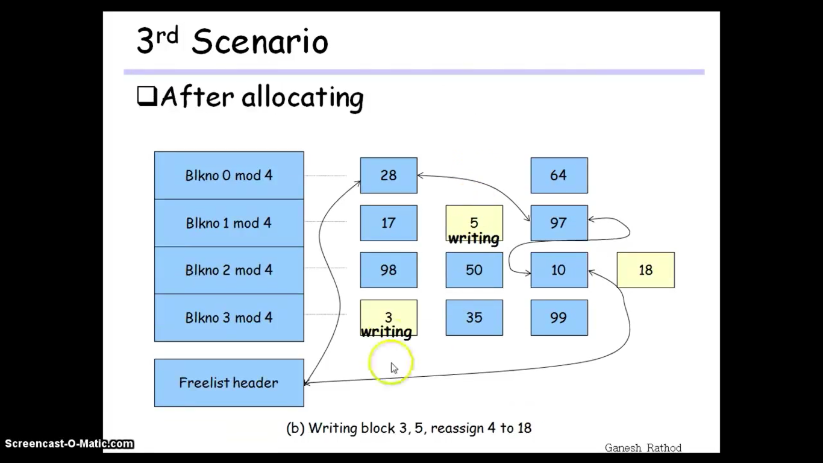

Slide 53
Scenario 3
Requested buffer not on hash queue, so the kernel also has to allocate a buffer from the free list.
However, it discovers that the buffer it removes from the free list has been marked for "delayed write," so it must write the contents of the buffer to disk before using the buffer.
The kernel starts an asynchronous write to disk and removes the delayed write buffer from free list.
And the kernel tries to allocate another(next free) buffer from the free list for the requesting process.
When the asynchronous write completes for the delayed write buffer, the kernel releases the buffer and places it at the head of the free list

Slide 54
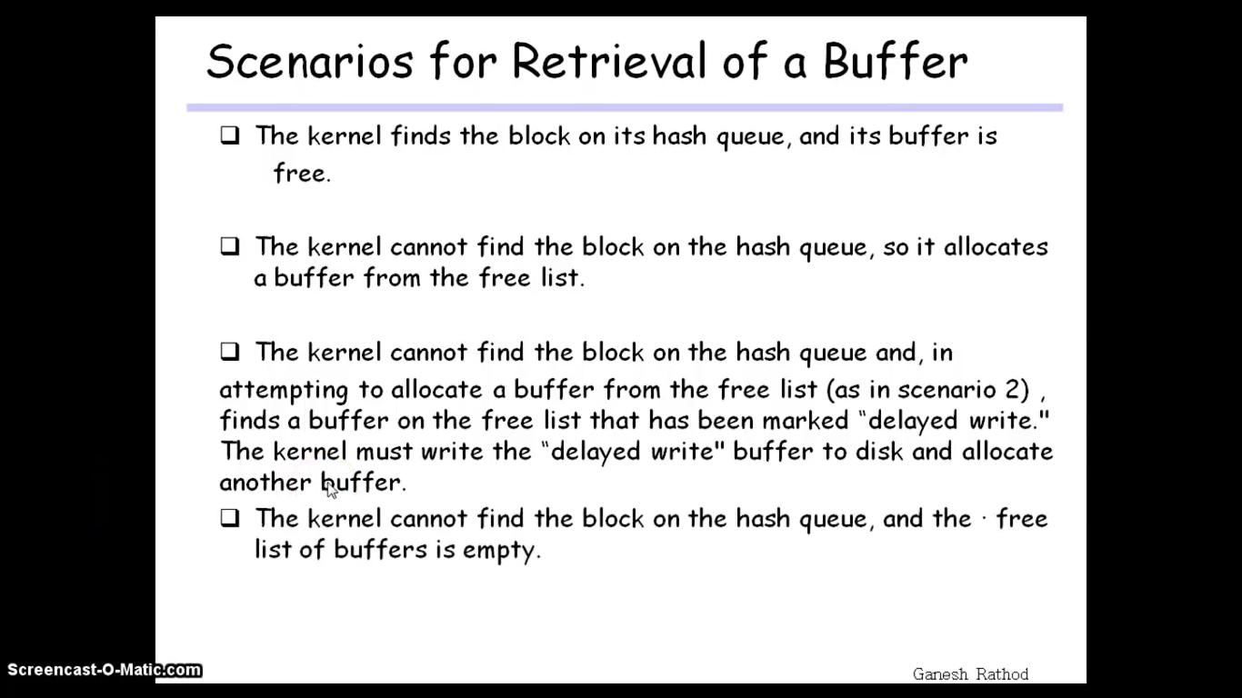

Slide 55
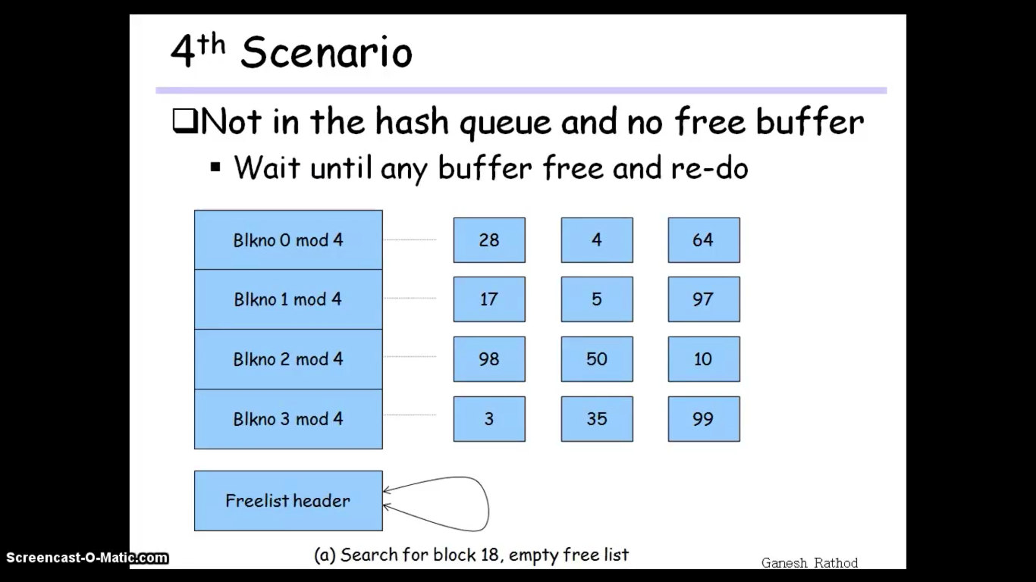

Slide 56
Scenario 4
Here the requested buffer 18 it not on the hash queue, so the kernel attempts to allocate a new buffer from the free list, as in the second scenario.
However, no buffers are available on the free list, so process A goes to sleep until another process frees a buffer.
When the kernel schedules process A, it must search the hash queue again for the block.
It cannot allocate a buffer immediately from the free list, because it is possible that several processes were waiting for a free buffer and that one of them allocated a newly freed buffer.

Slide 57
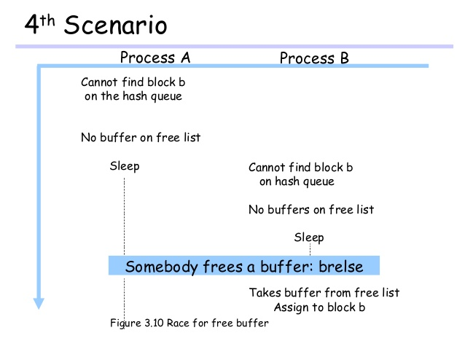

Slide 58
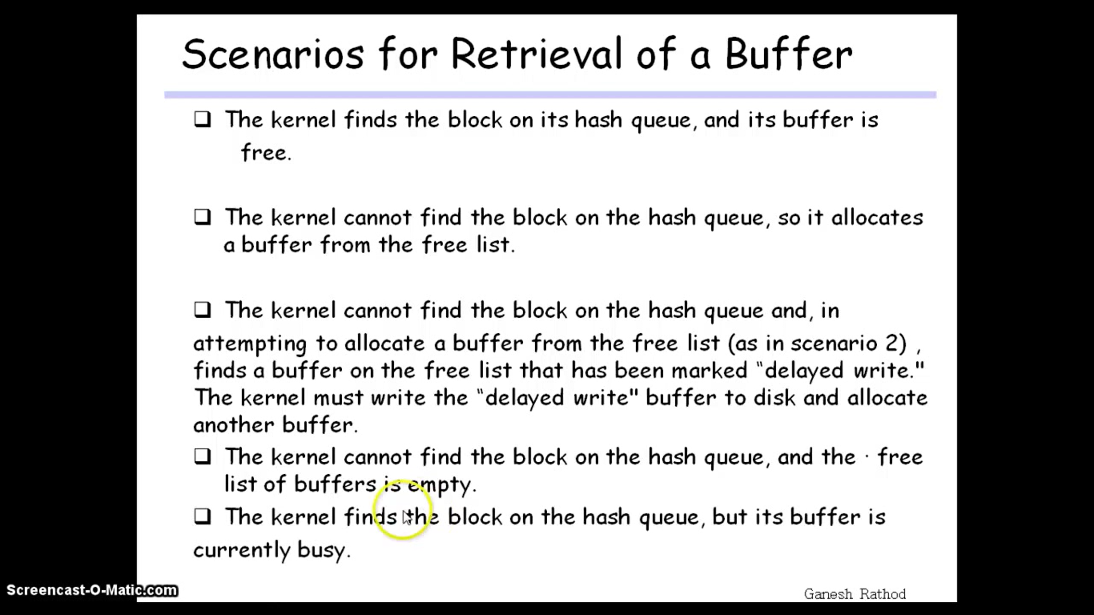

Slide 59
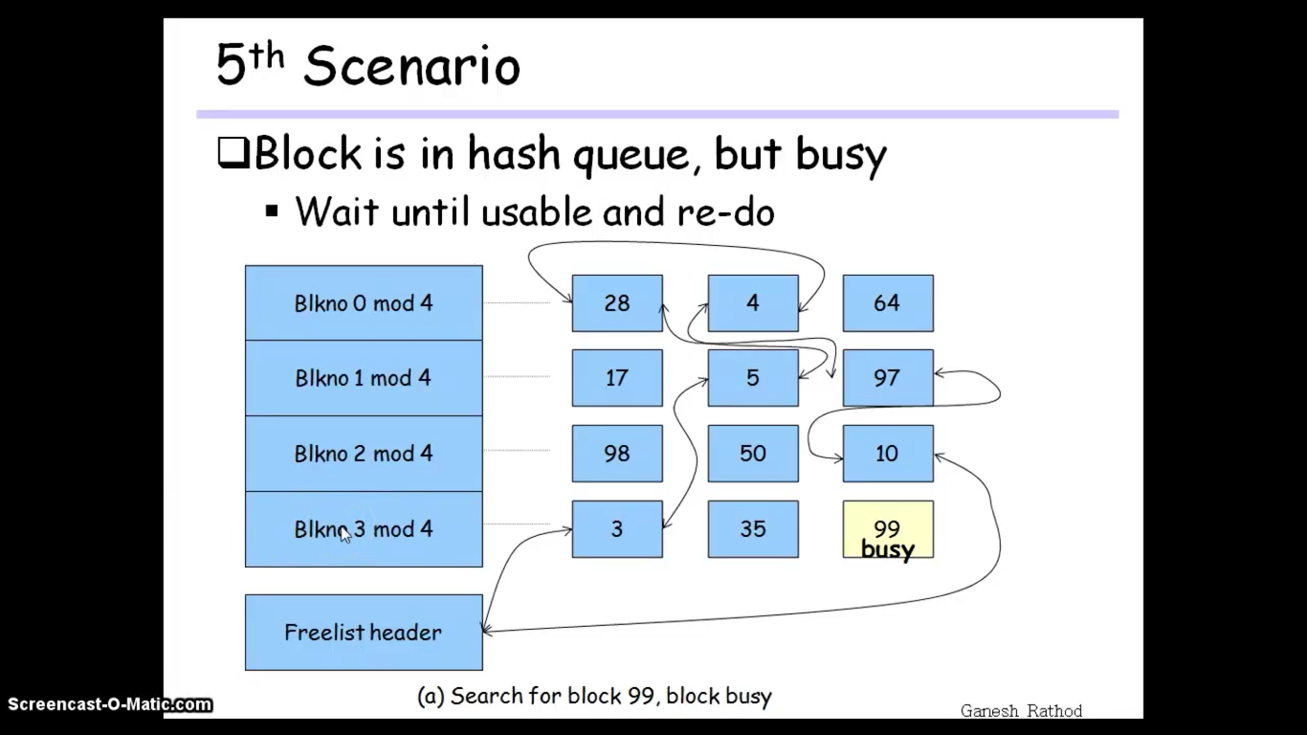

Slide 60
Scenario 5
Process B (going through scenario 5) will find the requested block, locked on the hash queue.
Since it is illegal to use a locked buffer and it is illegal to allocate a second buffer for a disk block, process B marks the buffer "in demand" and then sleeps and waits for process A to release the buffer.
Process A will eventually release the buffer and notice that the buffer is in demand.
It awakens all processes sleeping on the event "the buffer becomes free,“ including process B.
When the kernel again schedules process B, process B must verify that the buffer is free.

Slide 61
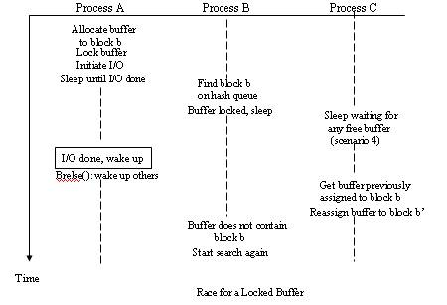

Slide 62
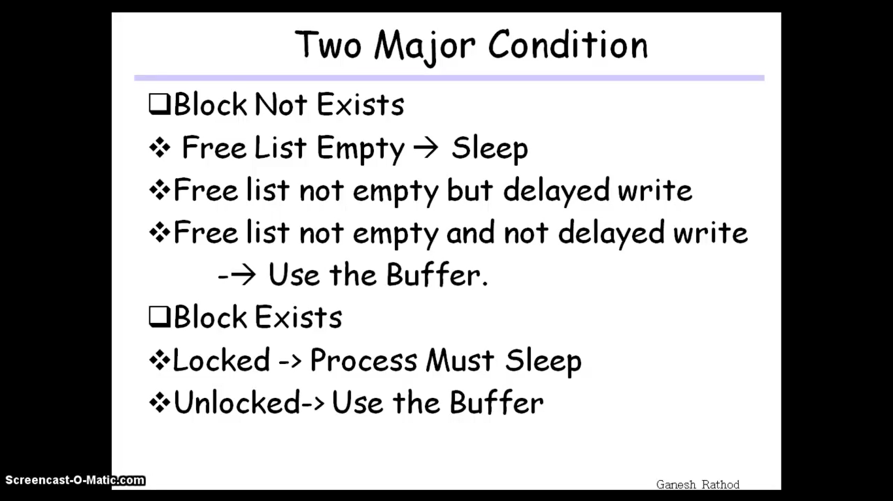

Slide 63
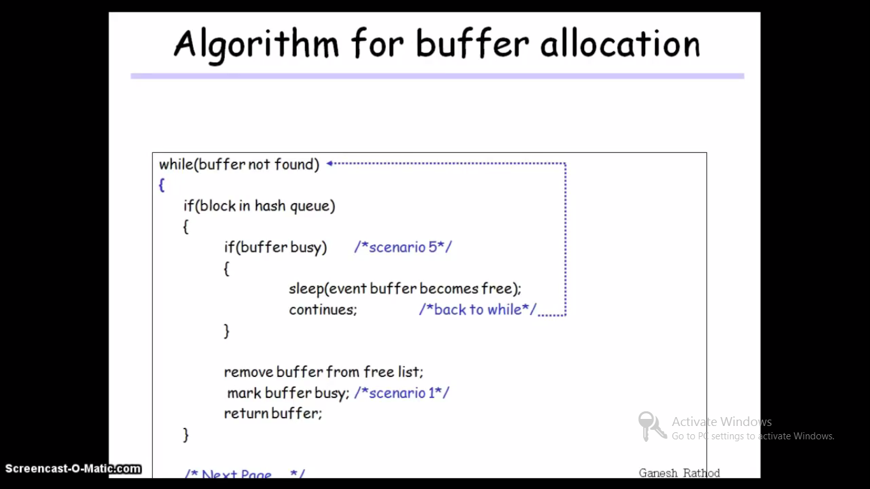
Algorithm: getblk()
Input: File System Number, Block Number
Output: Locked Buffer that can now be used for block

Slide 64
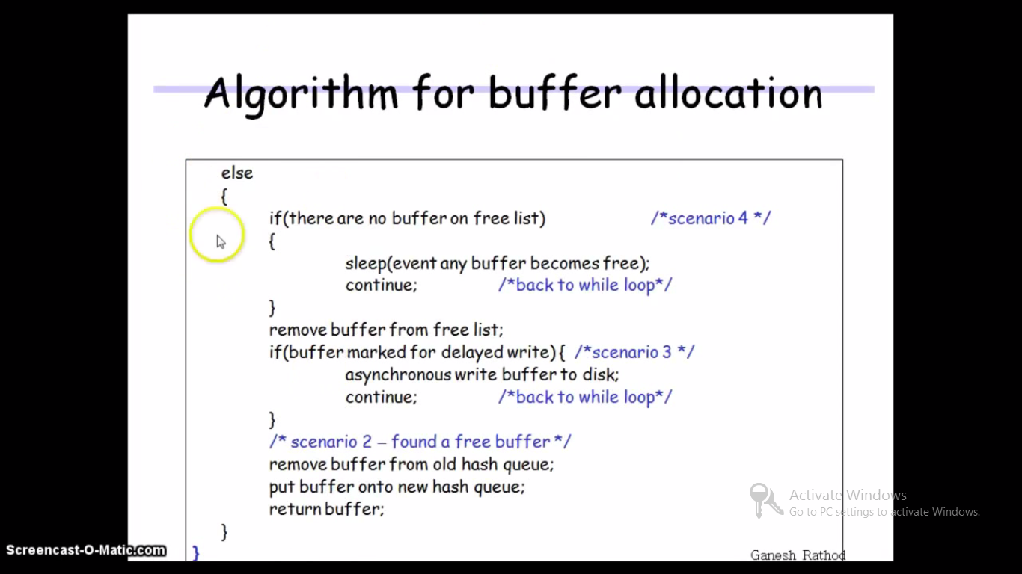

Slide 65
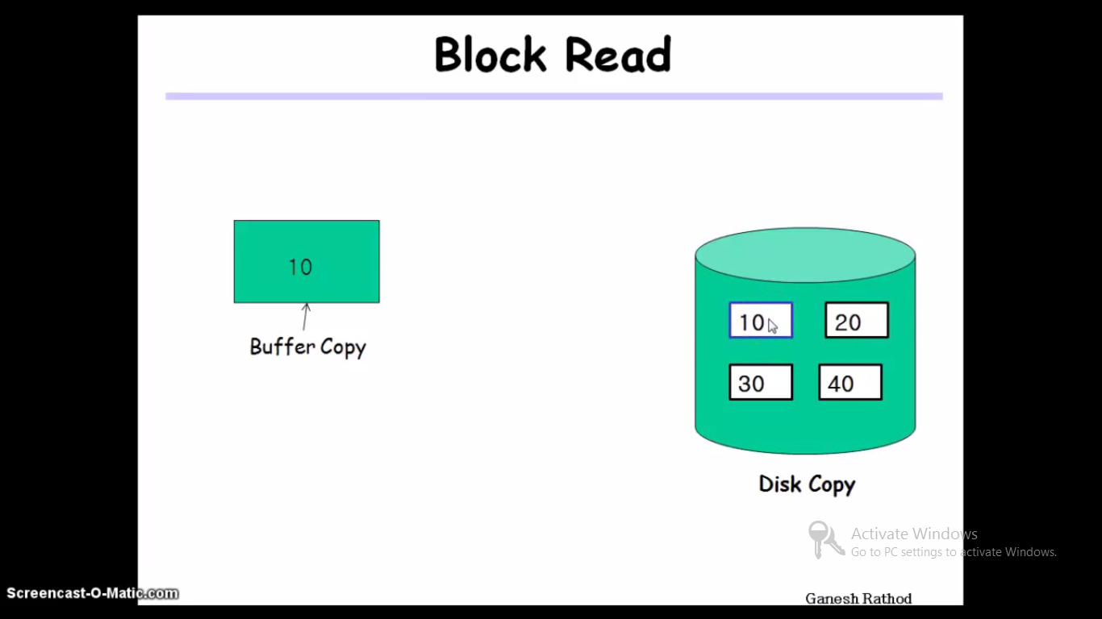

Slide 66


Slide 67


Slide 68
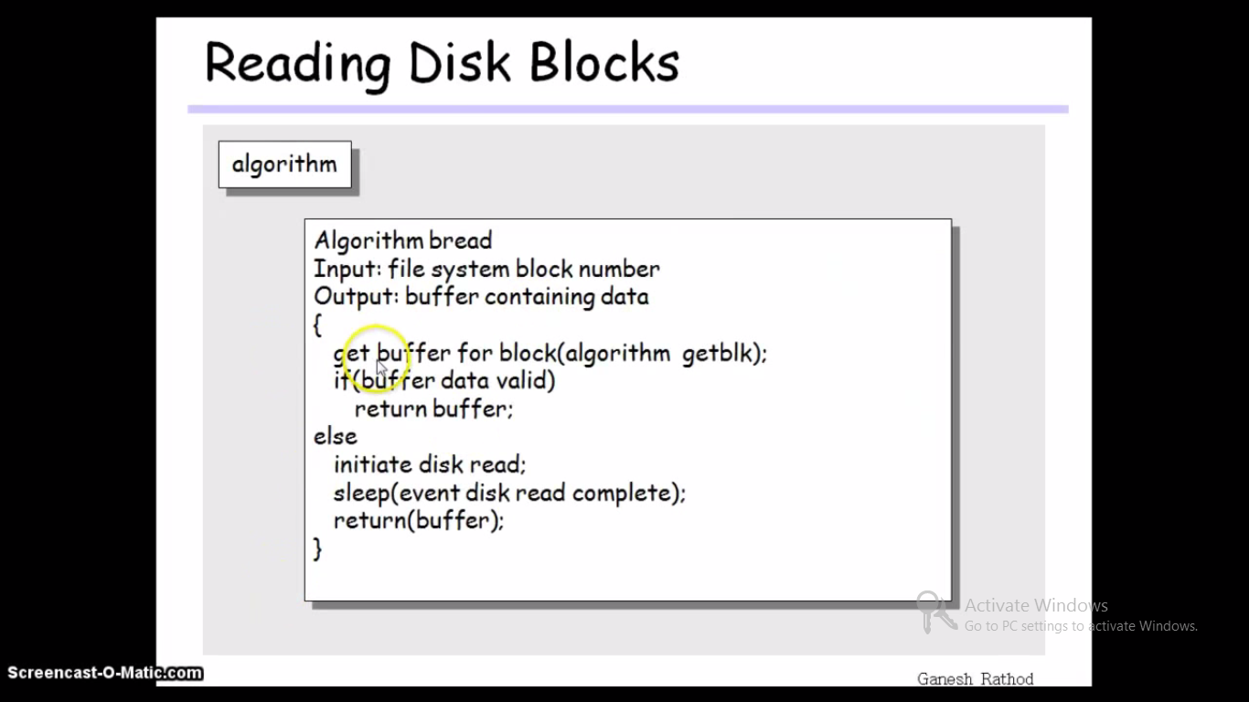

Slide 69
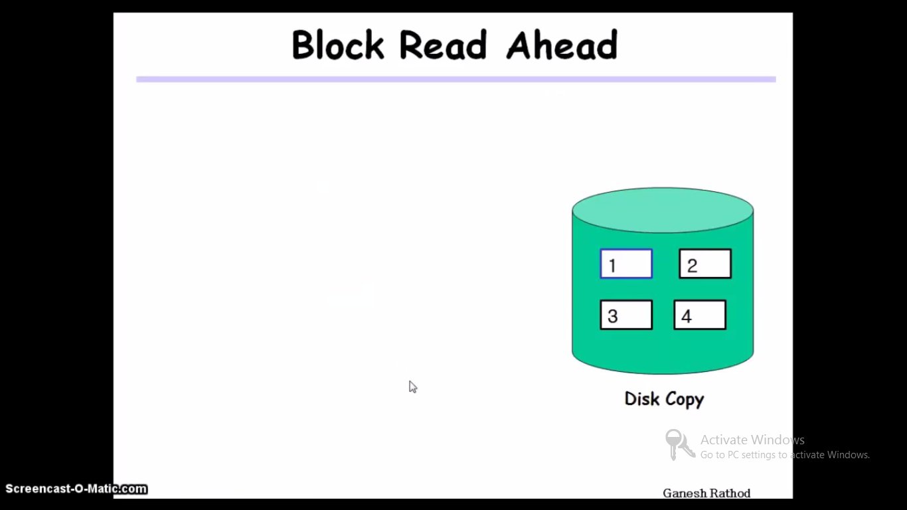

Slide 70
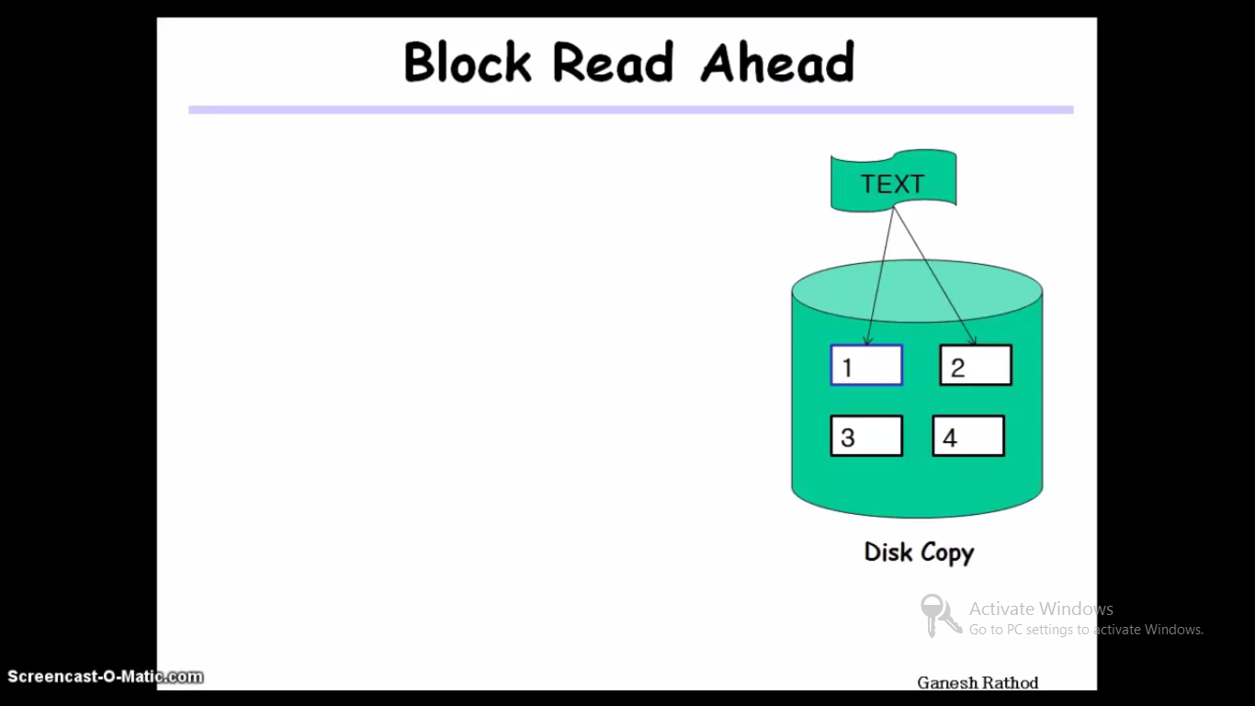

Slide 71
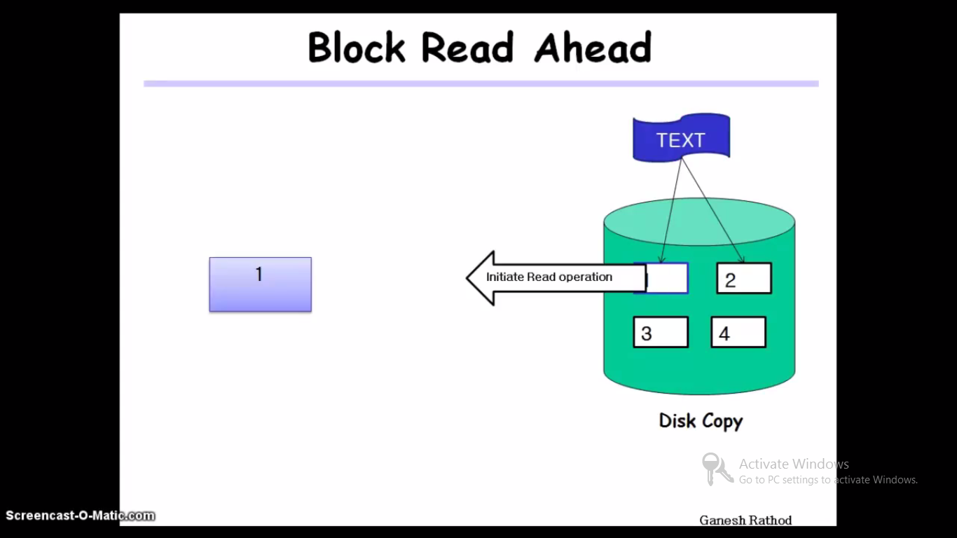

Slide 72
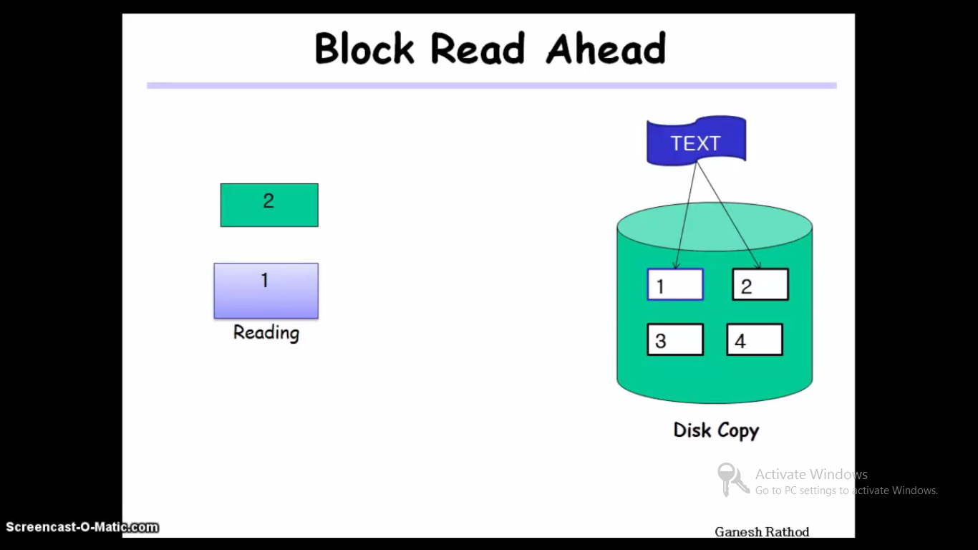

Slide 73
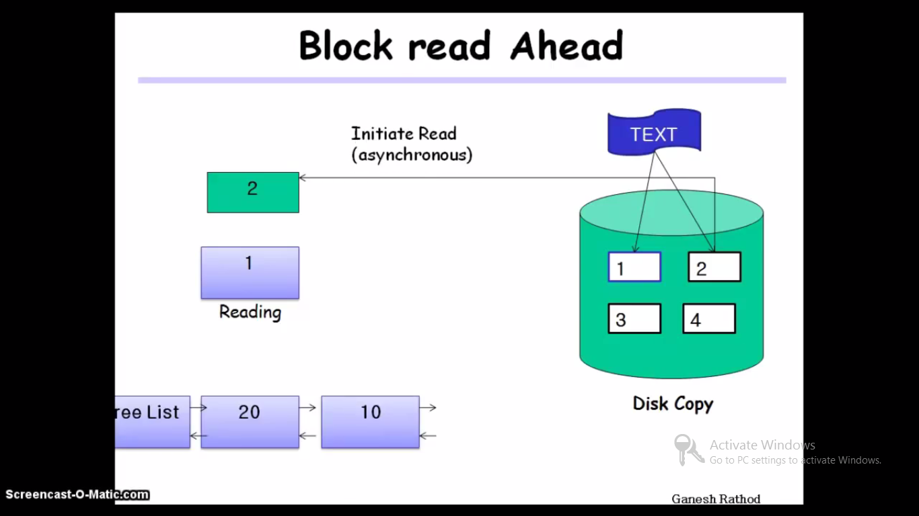

Slide 74
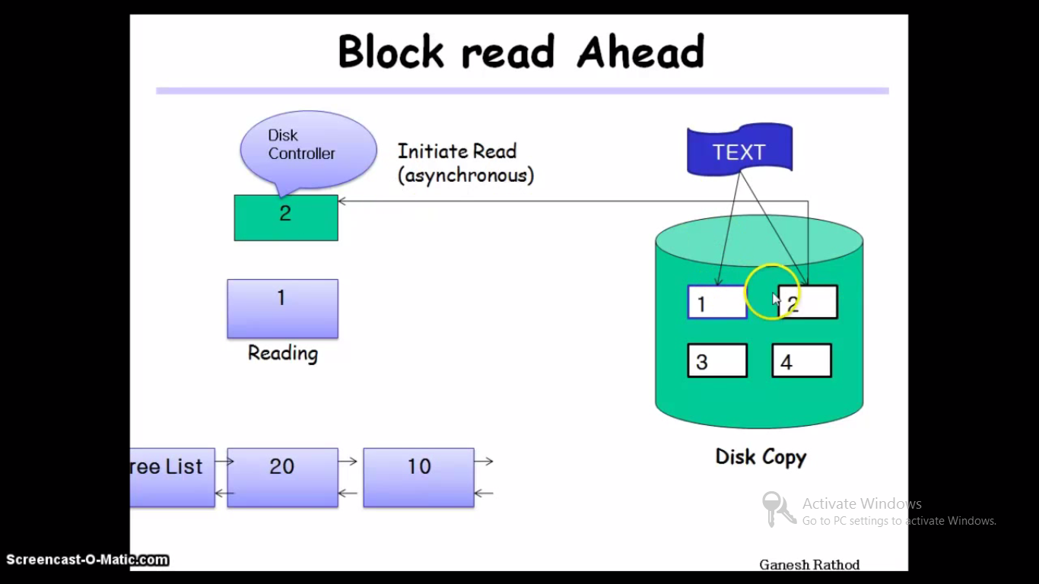

Slide 75
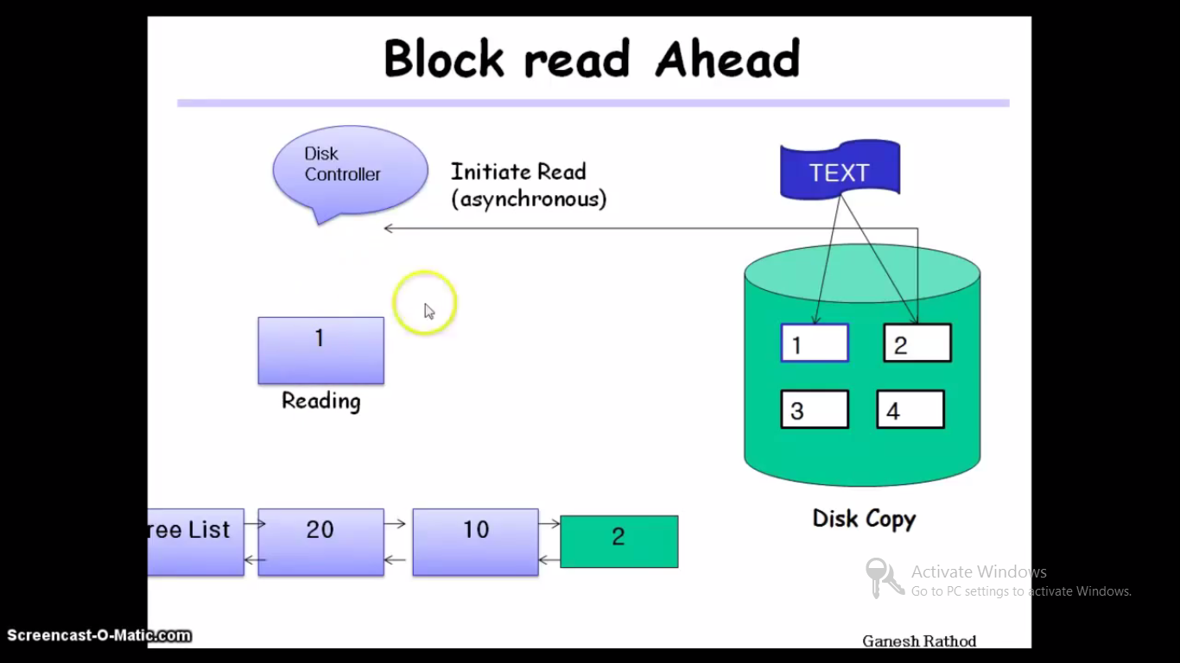

Slide 76
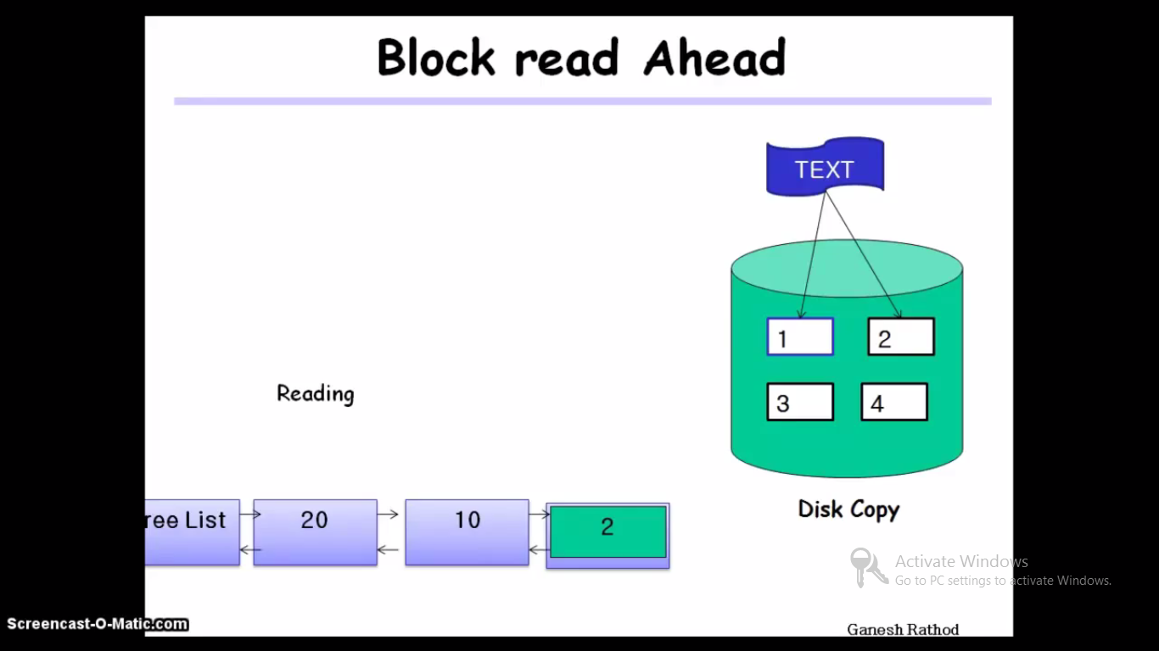

Slide 77
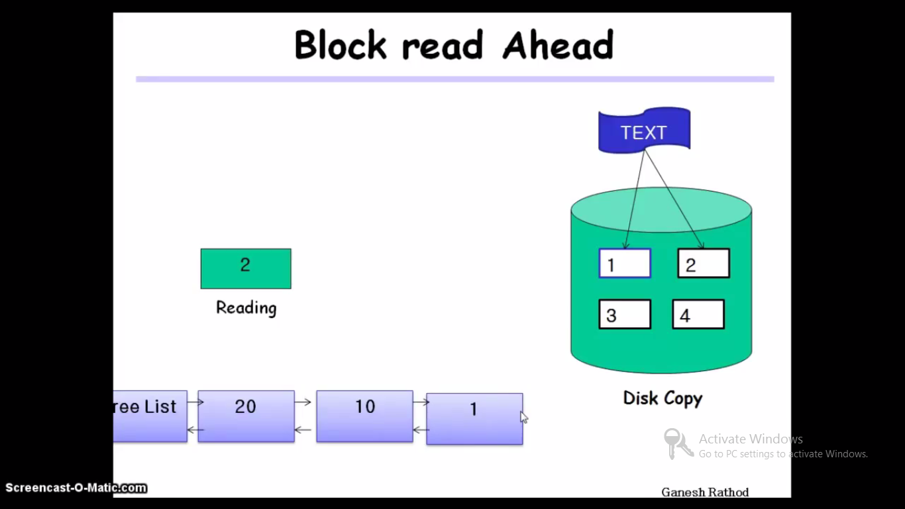

Slide 78
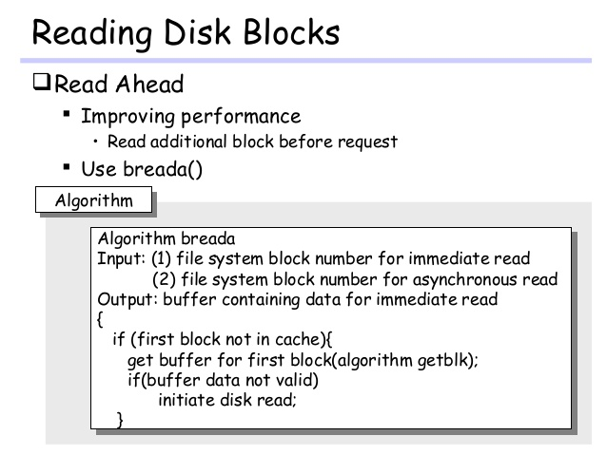

Slide 79
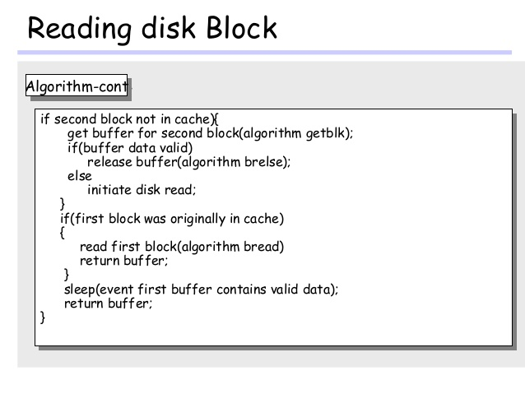

Slide 80
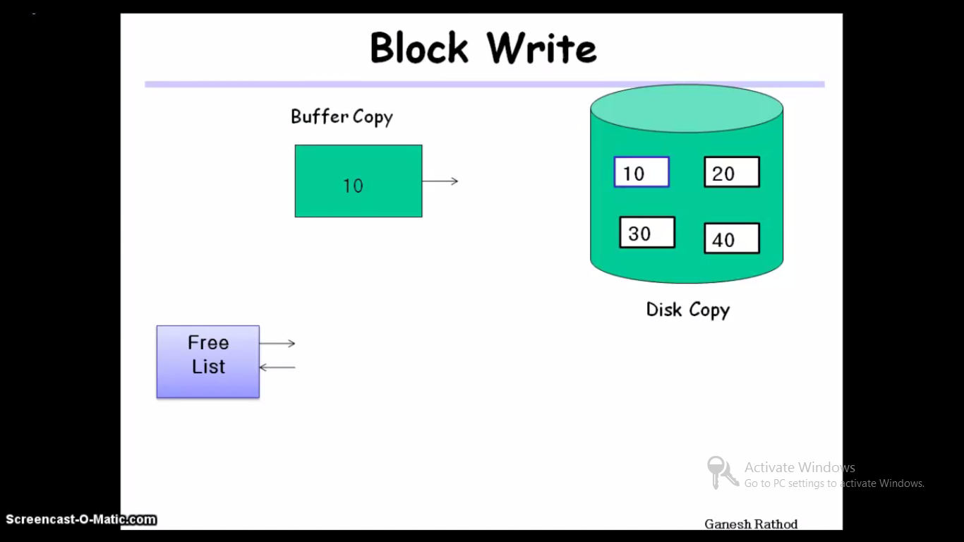

Slide 81
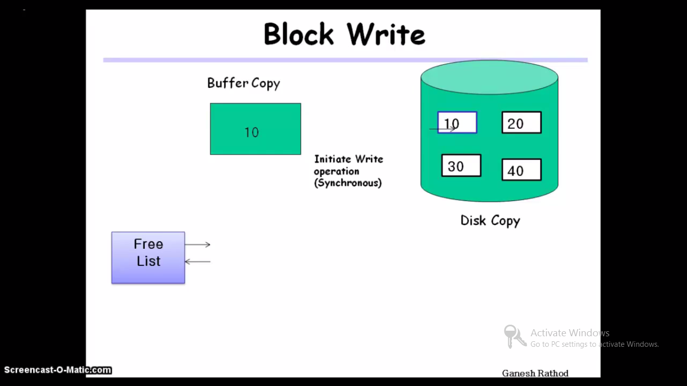

Slide 82


Slide 83


Slide 84


Slide 85

Raise processor execution level to block interrupts
Lower processor execution level to allow interrupts

Slide 86


Slide 87


Slide 88
Thank you!

